Slide 1
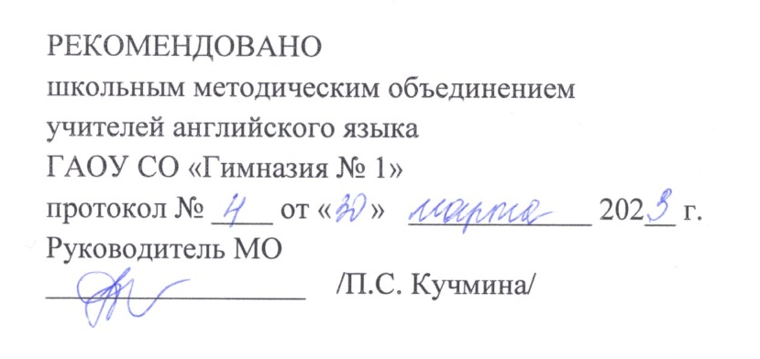
Тема: «Саратов-мой родной город»
Класс: 7
Предмет: английский язык
Автор: Перепелкина Наталья Геннадьевна,
учитель английского языка
ГАОУ СО «Гимназия №1»
г. Саратова

Slide 2
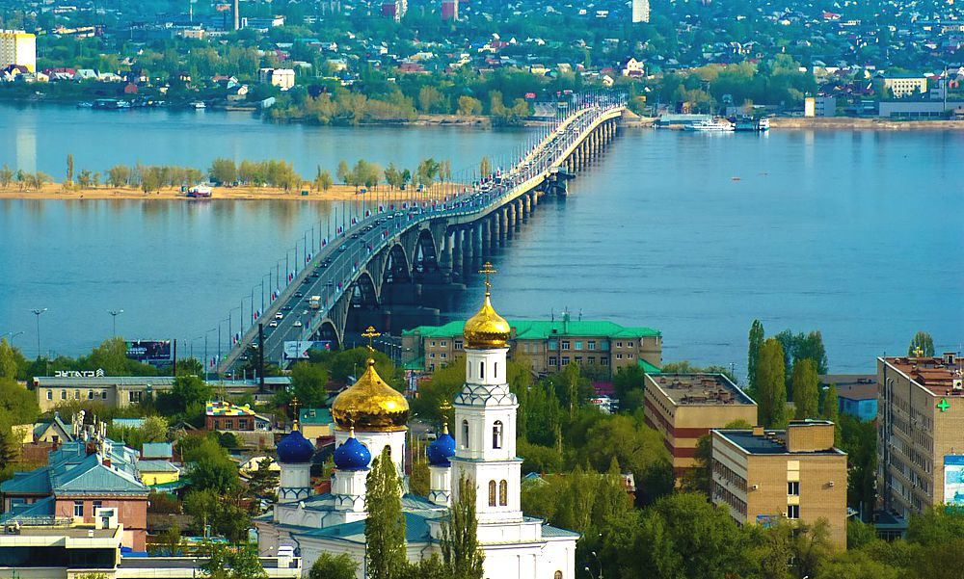
I am going to tell you about Saratov.
It is my native town.

Slide 3
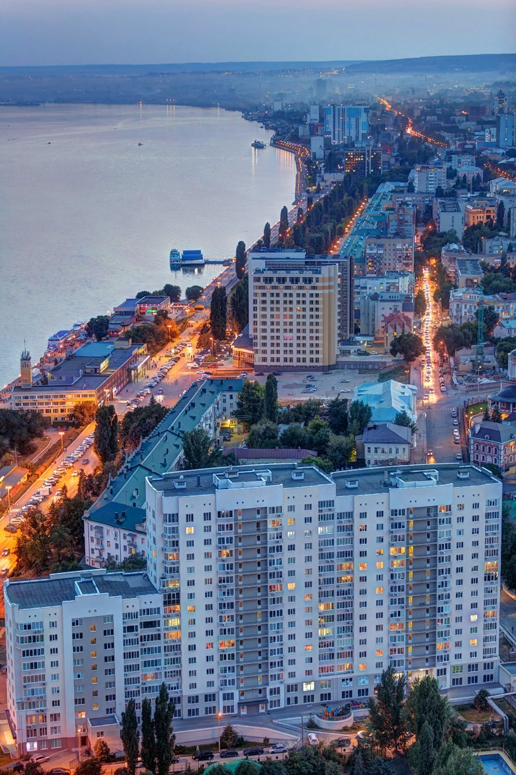
Saratov is one of the biggest and most beautiful cities in the Volga region. It was founded in 1590. Its population is over 840 000 people. The city stretches out for over 50 kilometers along the right bank of the Volga.

Slide 4
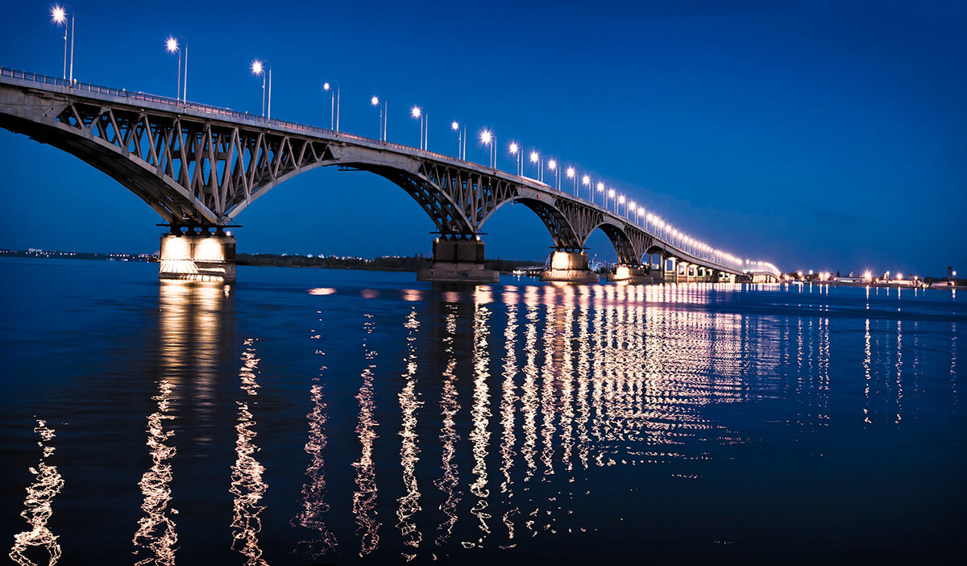
When tourists come to Saratov by ship or by plane, they enjoy the sights of its main landmarks. The first one is the magnificent bridge across the Volga, which is the longest in Europe.

Slide 5
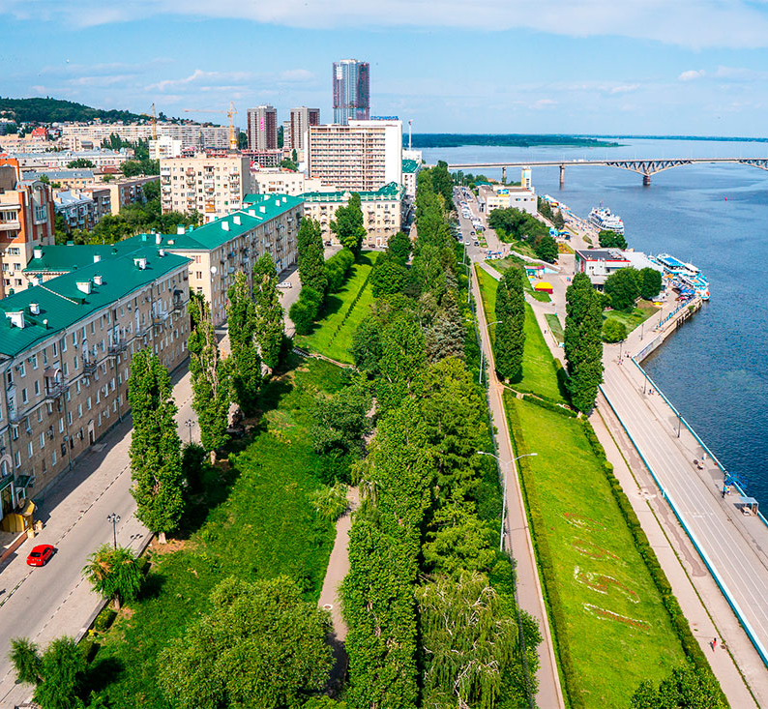
The second landmark is the Embankment named after cosmonauts. The citizens of Saratov like walking, cycling and skateboarding there.

Slide 6
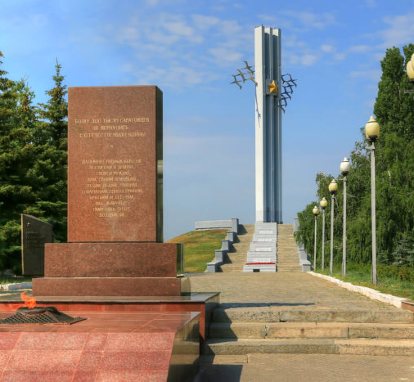
The third sight is the monument “Cranes” on Sokolovaya Hill which commemorates those who perished in the Great Patriotic War.

Slide 7
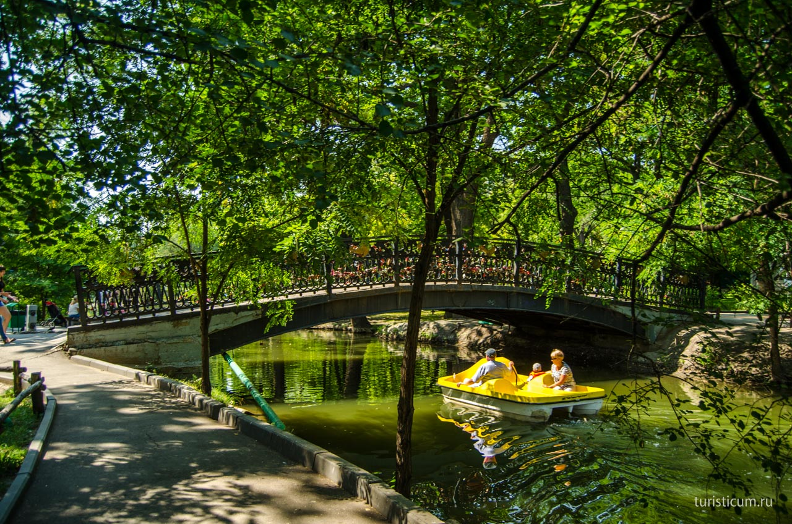
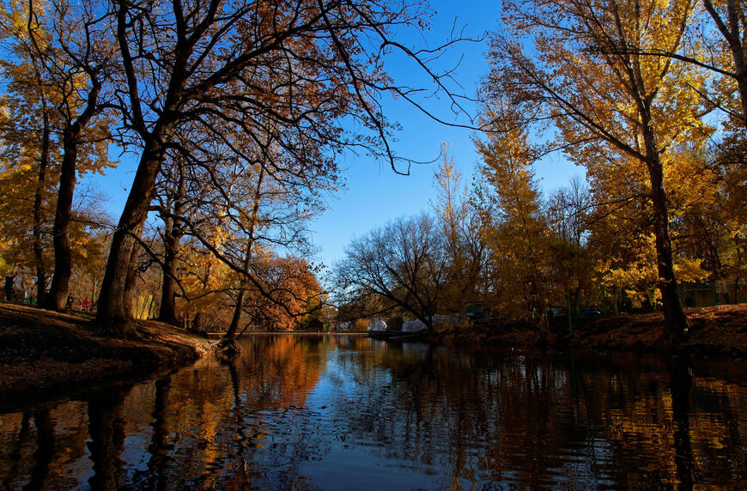
The City Park is famous for its old oak-trees planted 180 years ago and nice ponds where everyone can row a boat

Slide 8
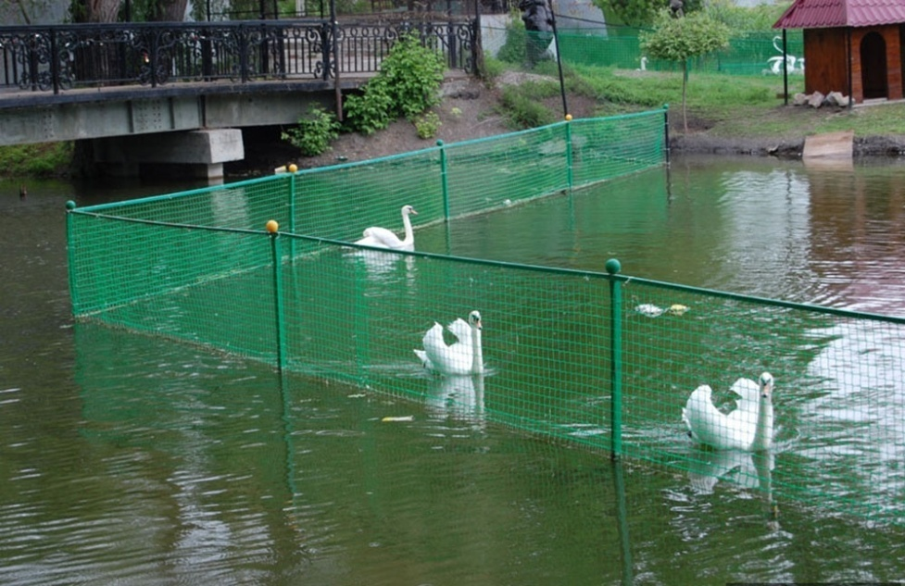
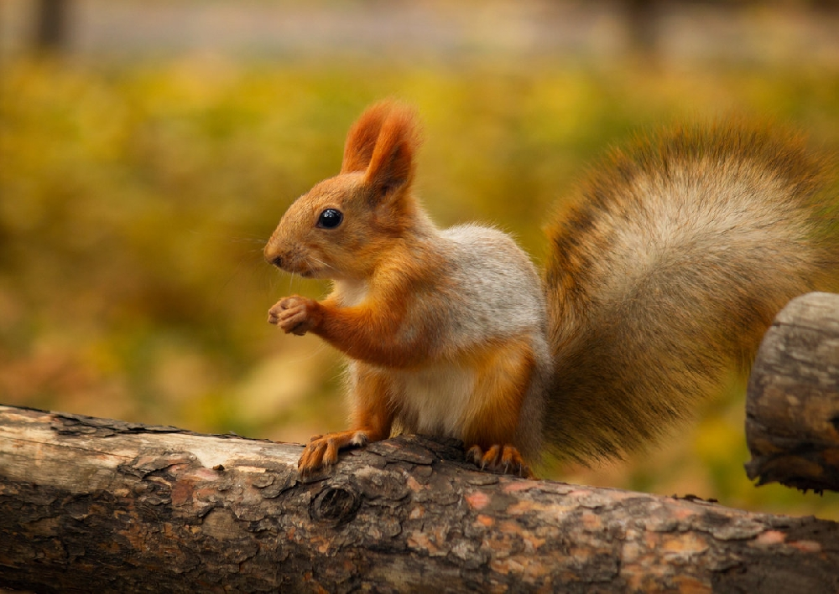
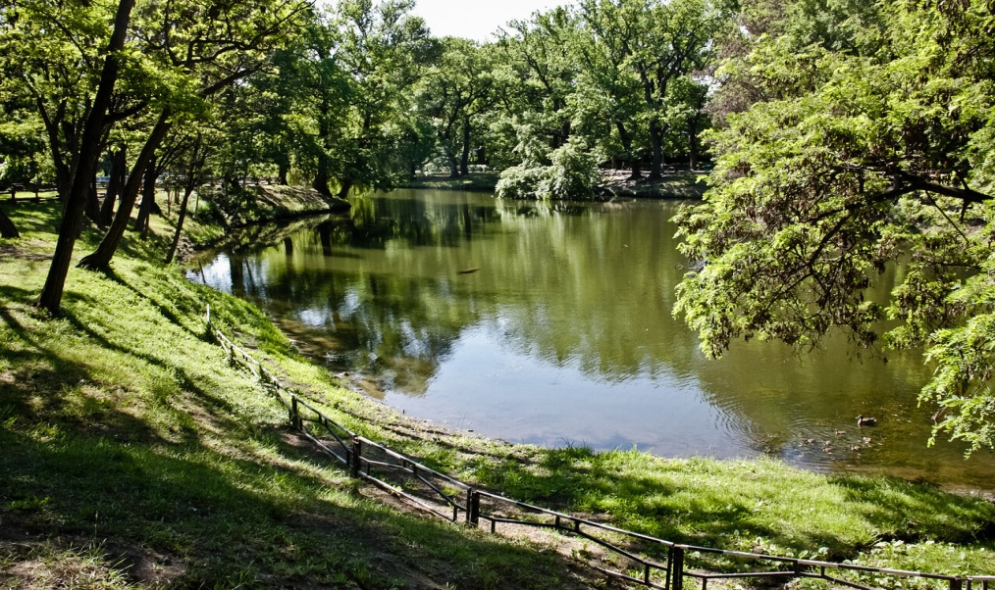
You can feed squirrels, watch swans and meditate.

Slide 9
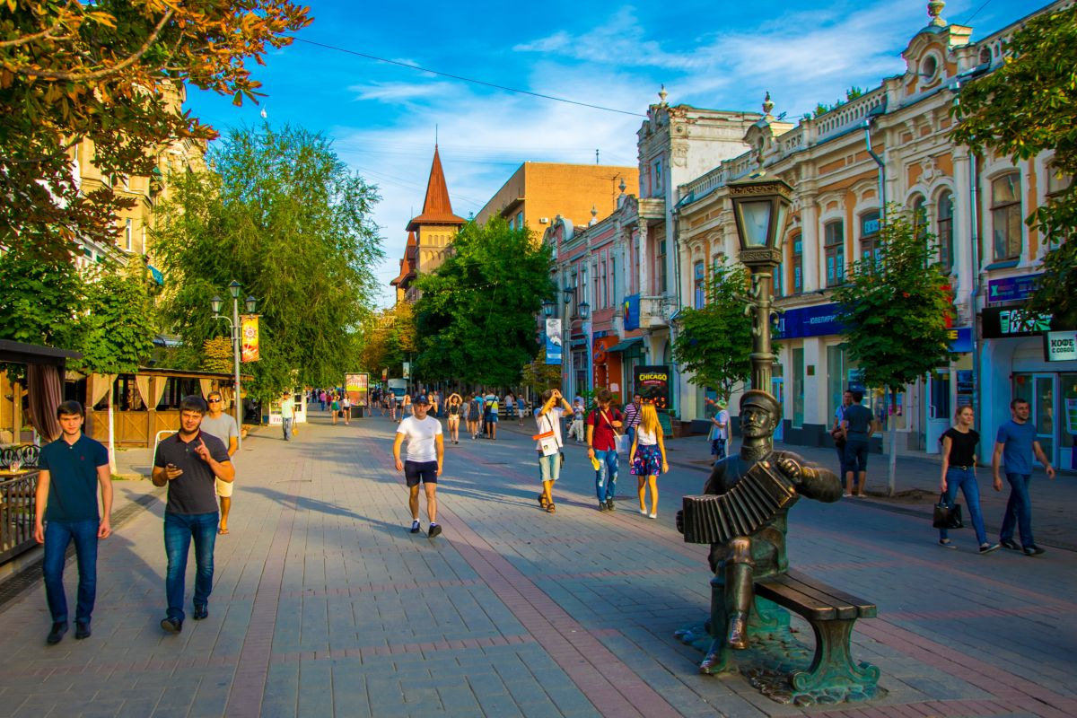
Besides, we are proud of Stolypin Avenue which is a traffic-free zone in the centre of the city.

Slide 10
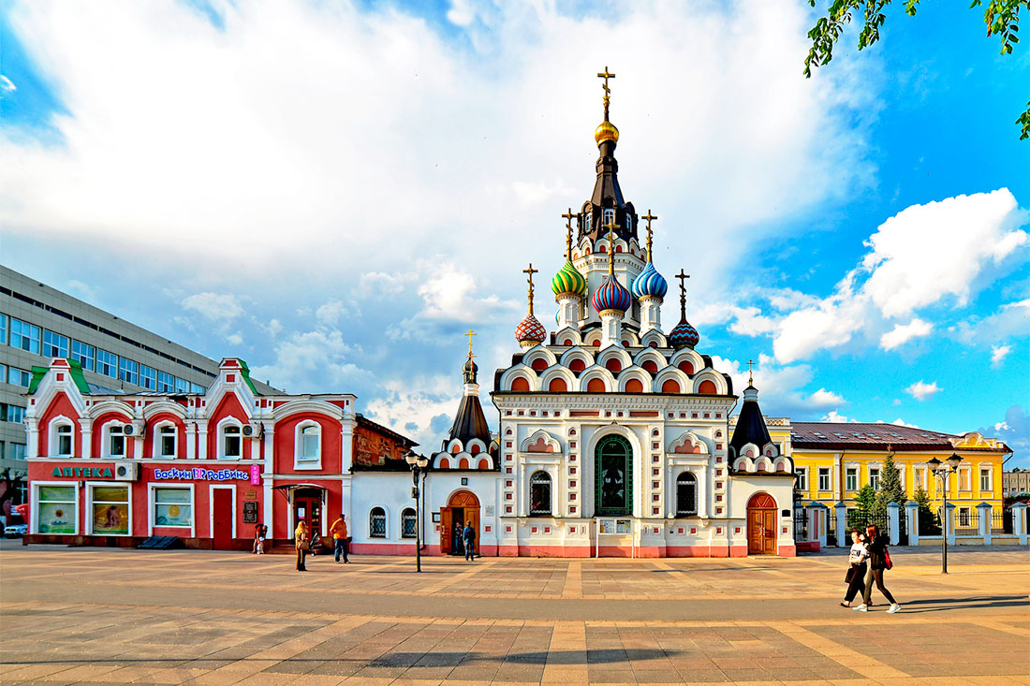
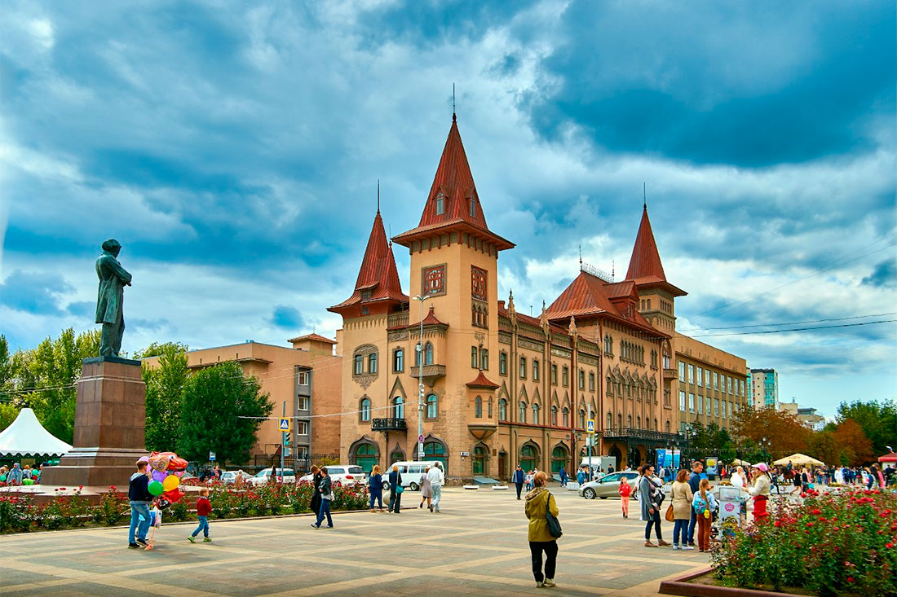
It begins with the square where one can see the church “Utoli Moya Pechali”, the monument to Nicolai Gavrilovich Chernyshevsky and the famous building of the Conservatory named after Leonid Sobinov in the Gothic style.

Slide 11
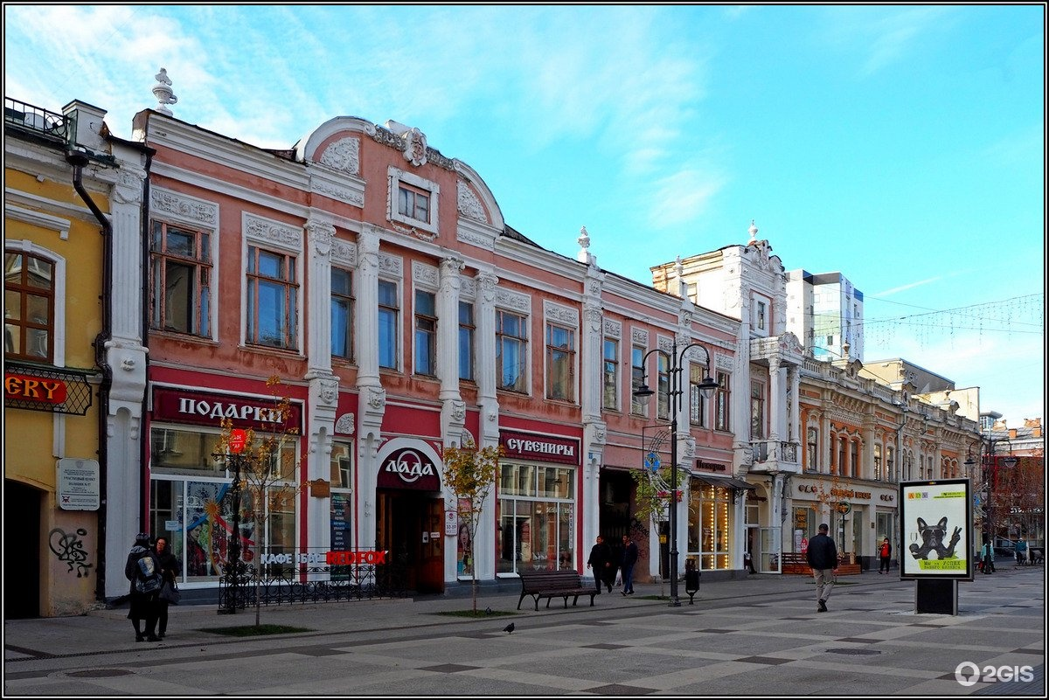
Many inhabitants and guests of Saratov like shopping at its various shops.

Slide 12
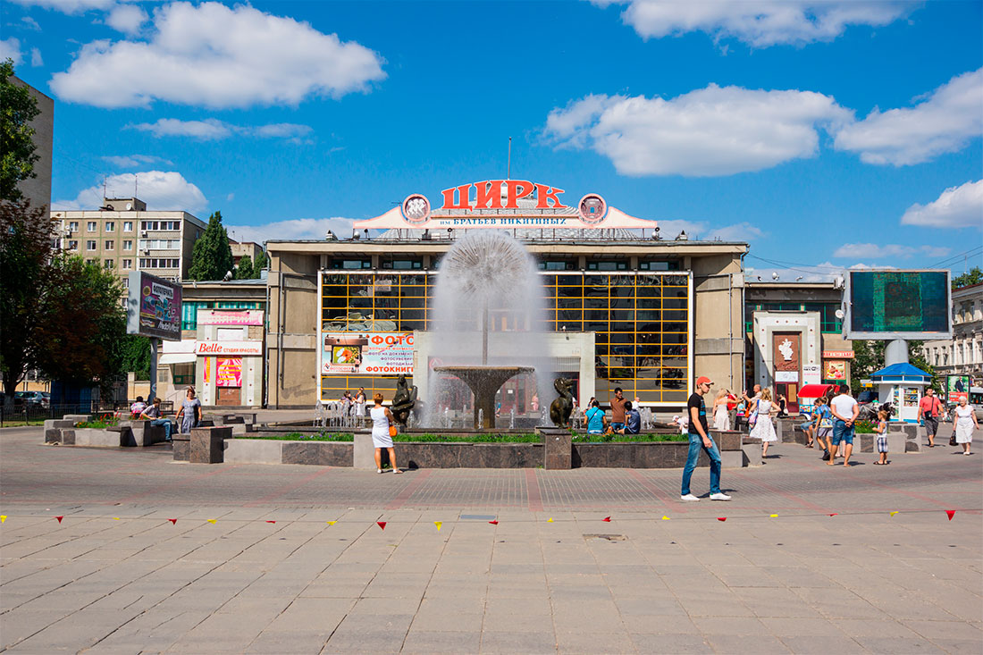
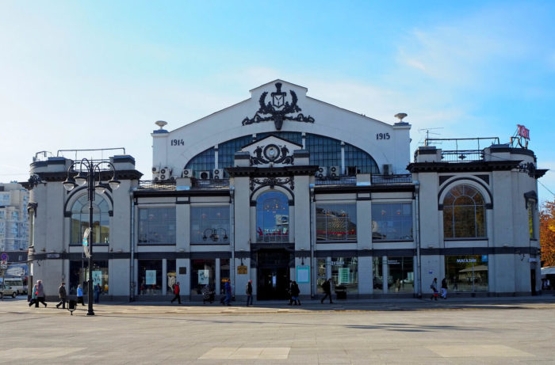
Stolypin Avenue reaches one more square with the circus, the fountain and the huge Covered Market built in 1916.

Slide 13
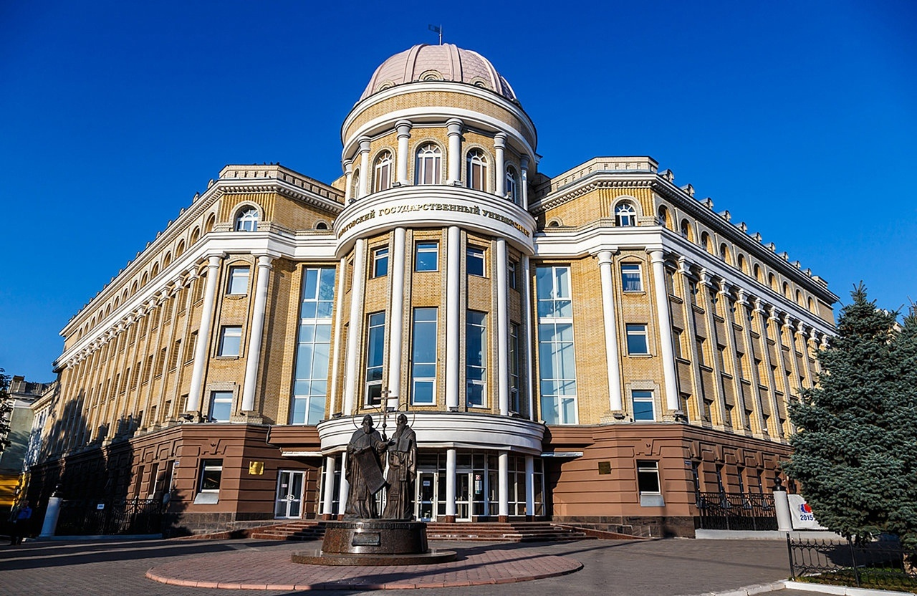
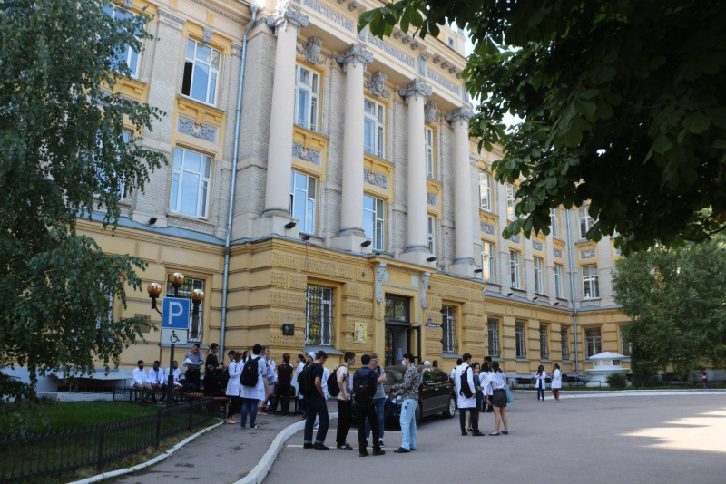
Saratov is often called a city of students with a great variety of higher institutions including the State University, the Medical University and many others.

Slide 14
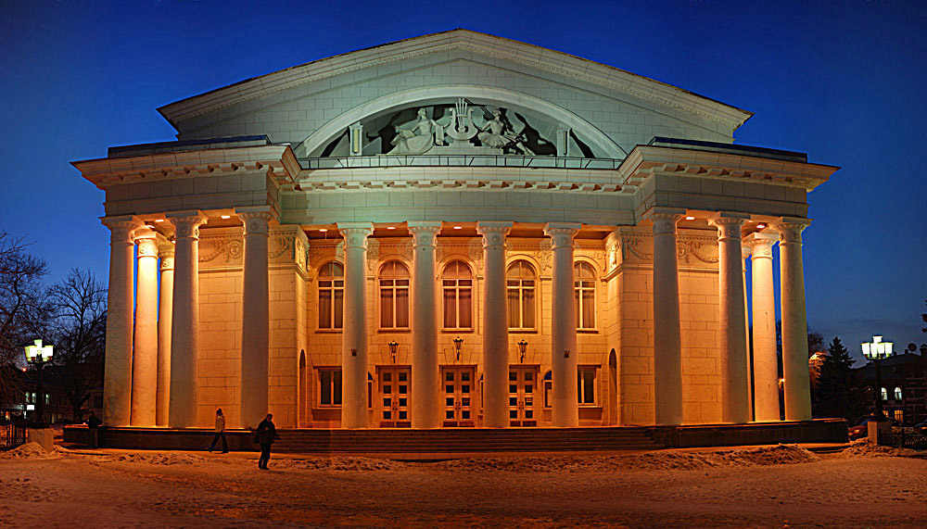
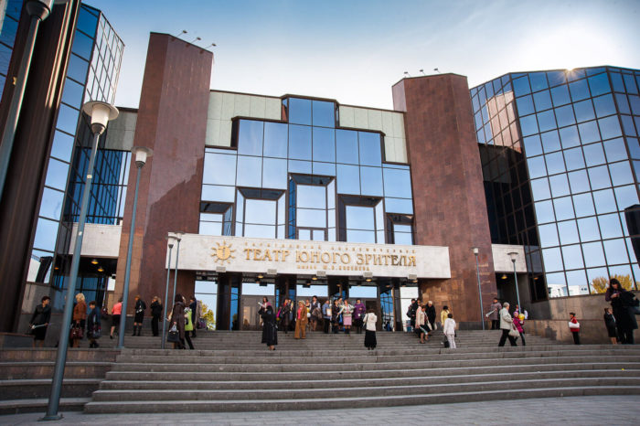
Saratov is also a centre of art, opera and drama. We often go to the theatres, for example, the Opera and Ballet Theatre or the Theatre of Young Spectators.

Slide 15
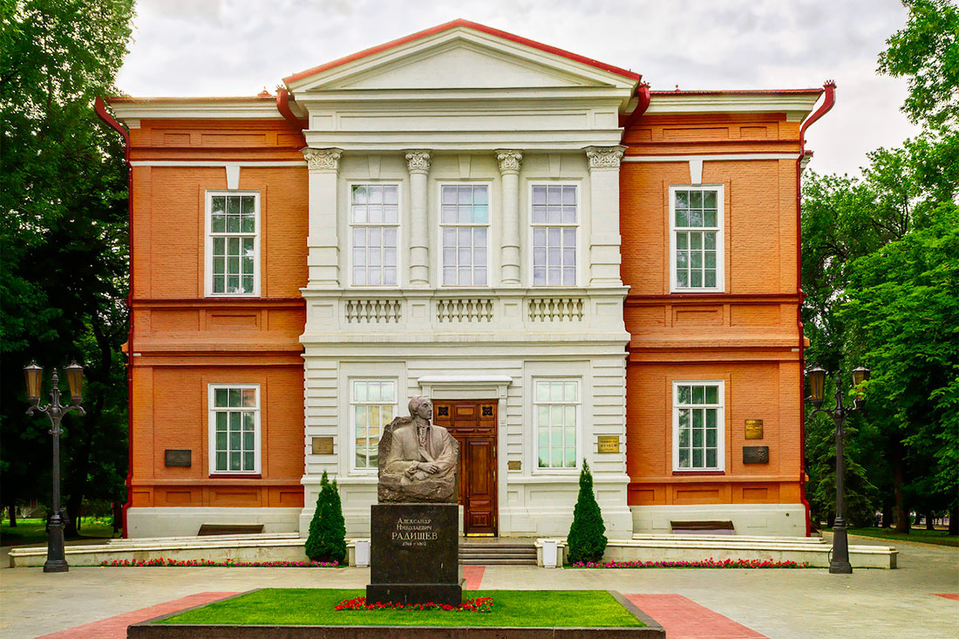
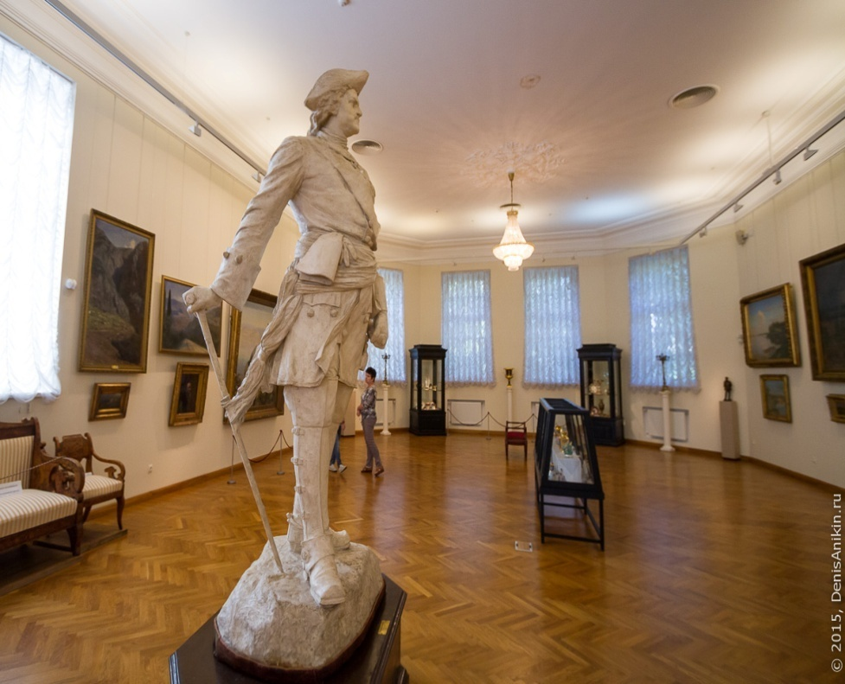
We also visit different museums, among them the Radishchev Art Gallery which houses a rich collection of pictures and sculptures.

Slide 16
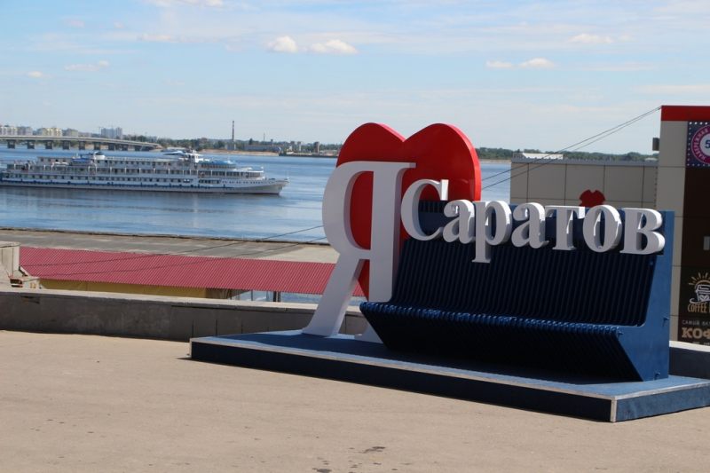
. I am proud of my city.

Slide 17
Использованные ресурсы
htthttps://wikiway.com/russia/saratov/photo/
htthttps://en.wikipedia.org/wiki/Saratov
https://yandex.ru/images/search

